Slide 1
Breaking Barriers To Unity

Slide 2
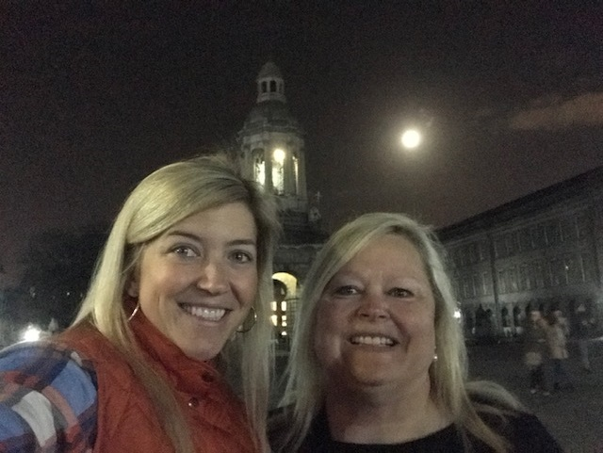
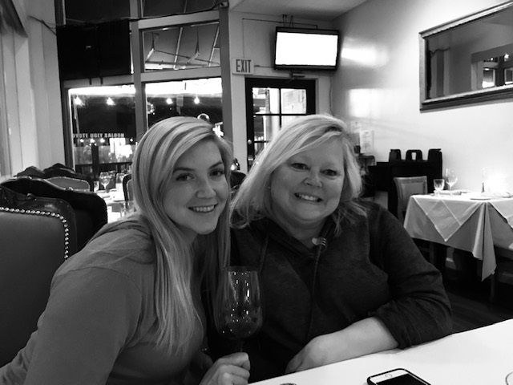
Uniting to build bridges
Kim Brainard
Lonnie Weaver-Johnson

Slide 3
World Café
Onshore vs Offshore
Leaders vs Teams
Feeling Unaccepted or Unequal

Slide 4
Onshore vs Offshore

Slide 5
Onshore vs offshore teams
As Onshore Teams
As Offshore Teams
Think about behaviors that keep you from being a team with our offshore teams?
What can you do, to connect and build relationships with your offshore Team members?
Think about behaviors that keep you from being a team with our onshore teams?
What can you do, to connect and build relationships with your onshore team members?

Slide 6
https://setandbma.wordpress.com/2012/07/09/agile-offshoring-2/

Slide 7
Barrier between
leaders & Teams

Slide 8
Questions: Leaders vs teams
Is it team members who assume there are barriers because they don’t feel empowered?
Do leaders build barriers through their actions?

Slide 9
Feeling unaccepted or Unequal

Slide 10
Feeling unaccepted or unequal
I have, or a colleague has been, shut down before by a domineering personality.
Economic status has kept me or someone else I know, from speaking up
Lacking confidence causes me to hold back
I, or someone I know, looks different than the norm due to hair style, weight, skin color, a disability, or some other distinguishable feature and as a result has held back or didn’t get heard.
Because of gender, I have or someone I know has, held back in social settings, meeting, etc.

Slide 11
The Five Scrum Values
Respect
Openness
Focus
Commitment
Courage
5
Scrum Values

Slide 12
Closing: Bridging outcomes
Understand differences do not have to mean conflict, in fact, recognizing that differences can even make us stronger and more unified
Recognizing we are all equal with the common human needs such as being heard, accepted, and respected
Understanding our own beliefs about conflict and reactions to it which prevent unity
A useful model for identifying some drivers underlying conflict

Slide 13
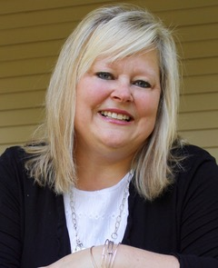
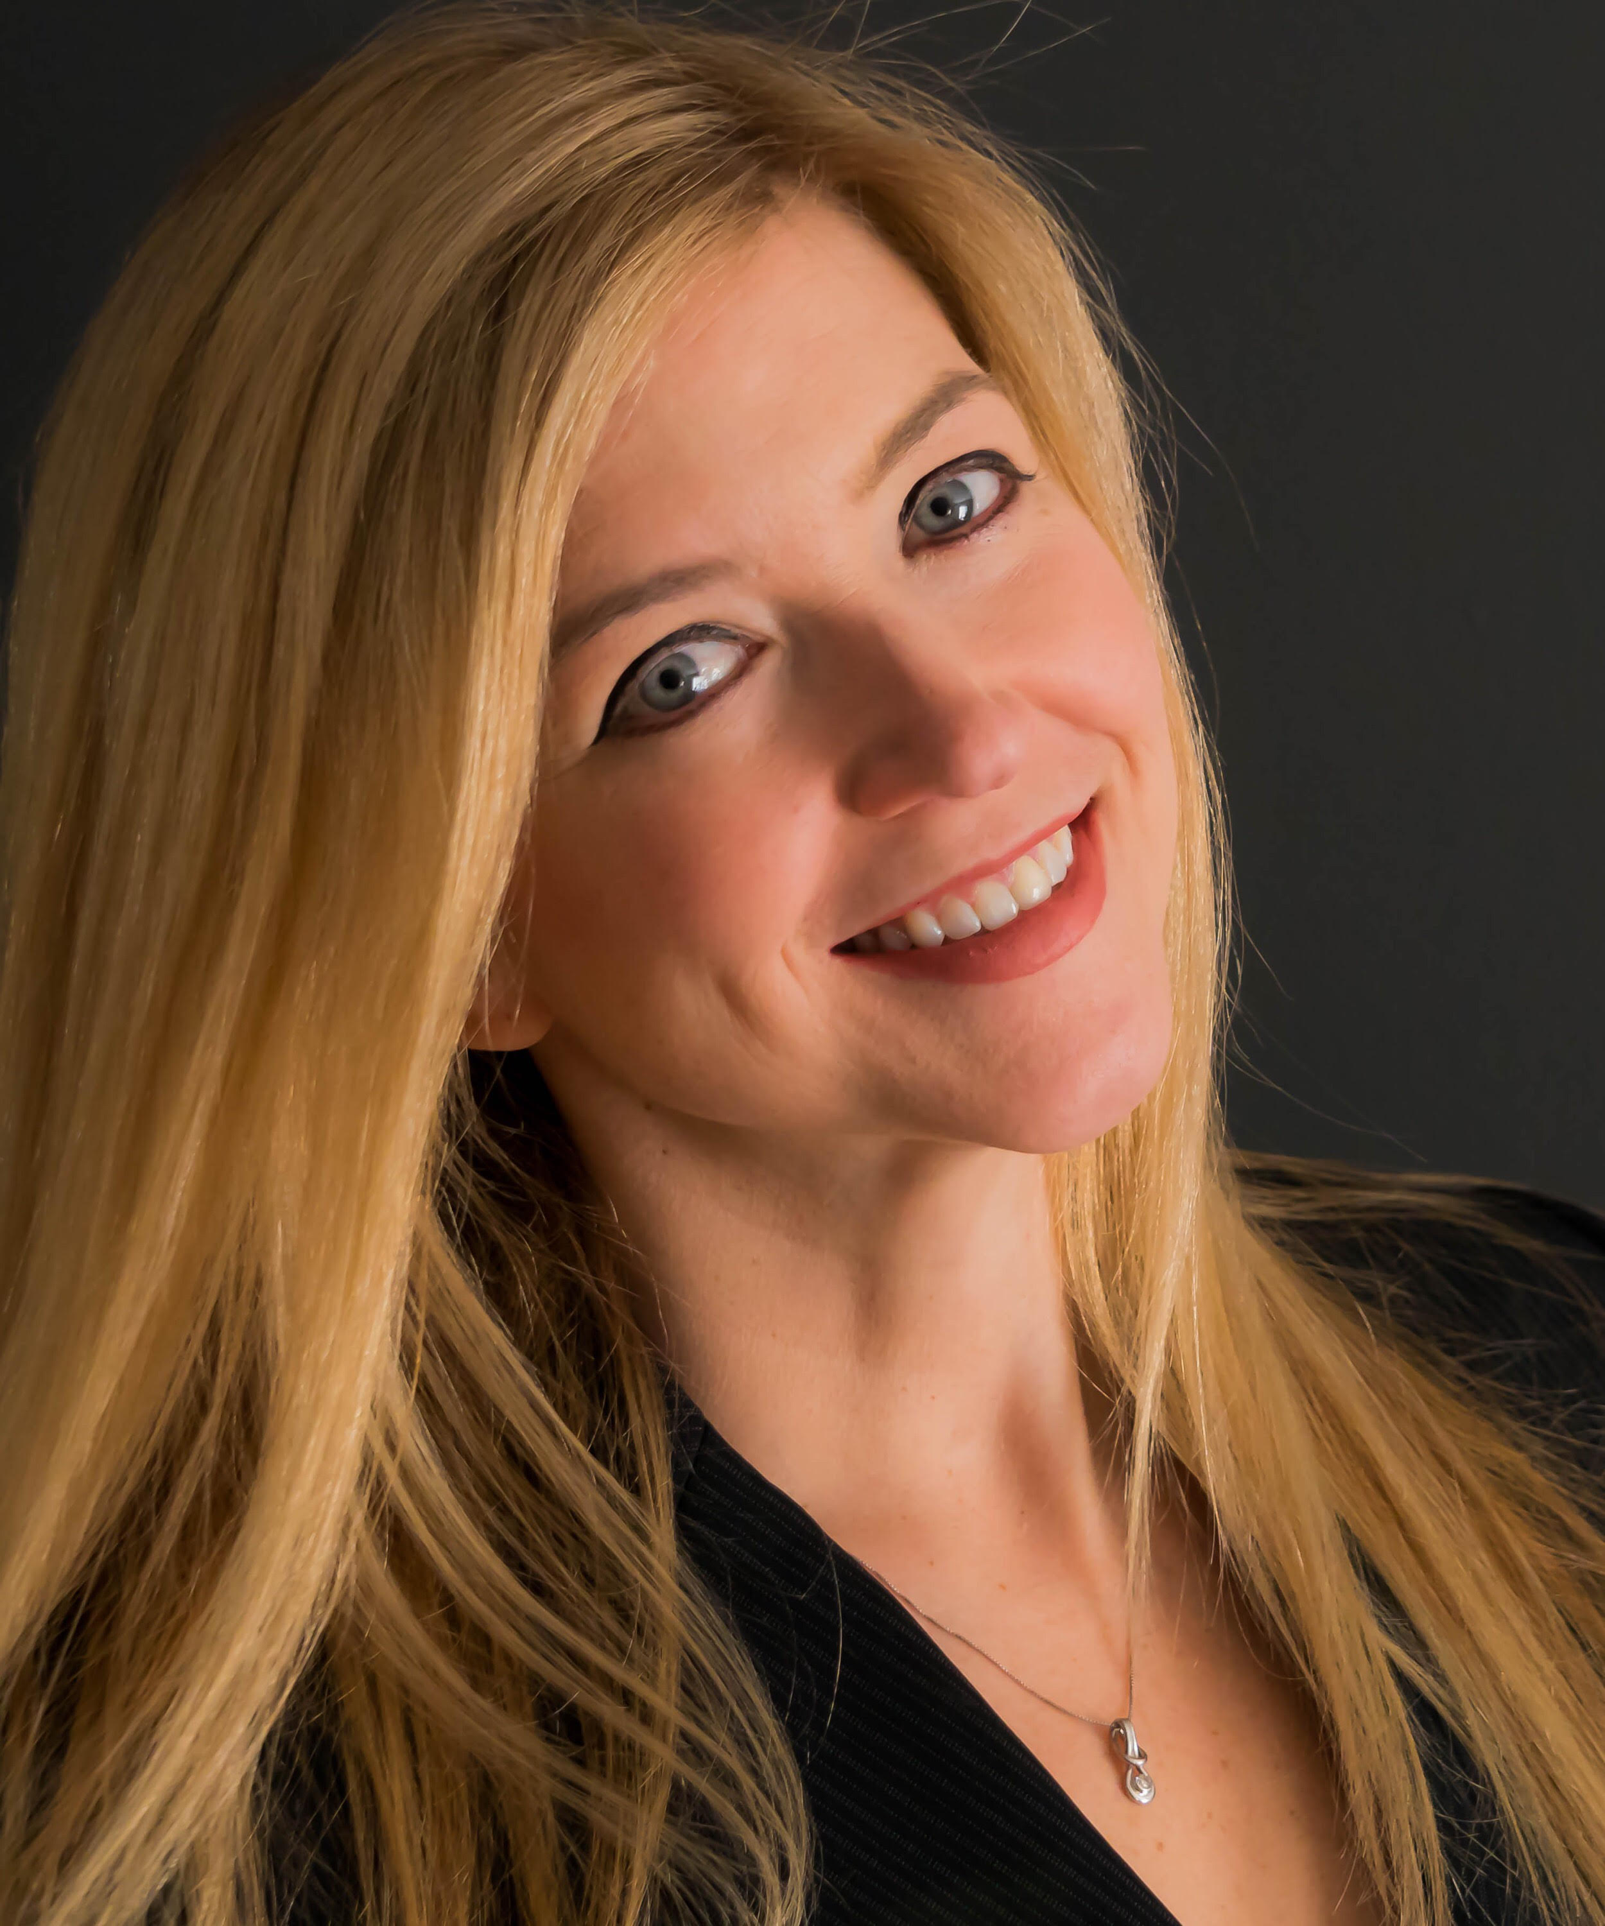
Together we can Bridge the gap
Thank You
Lonnie Weaver-Johnson
@Lonniewj
Lonnie@lwjsolutions.com
Kim Brainard
@agilebrain1
agilebrainard@gmail.com

