Slide 1
The Learning Consortium for the Creative Economy
February 19, 2015
Webinar will start 3 minutes after the hour

Slide 2
What is the Learning Consortium?
A. B. C. D.
Who is presenting today?
• Steve Denning is a board member of Scrum Alliance and combines several decades of management experience at the World Bank with many years of consulting and research on leadership and management issues. He now writes for Forbes.com. He is the author of eight books, including The Leader’s Guide To Radical Management (2010) and The Leader’s Guide To Storytelling (2010).
• Jay Goldstein is an adjunct lecturer in entrepreneurship at McCormick School of Engineering at Northwestern University. He teaches Entrepreneurial Selling and Scaling with the application of advanced Agile mind-sets and methods; he is a serial entrepreneur and was a founding partner in Jabbok River Group, which invests in early-stage companies to accelerate innovation and growth.
• Michael Pacanowsky is the director of the Center for Innovative Cultures at the Bill and Vieve Gore School of Business at Westminster College in Salt Lake City, Utah. He is also the Gore-Giovale Chair in Business Innovation at Westminster College. He worked for several decades with W. L. Gore and Associates.

Slide 3
The Learning Consortium for the Creative Economy
A. B. C. D.
Agenda
A. Recap on the Creative Economy
B. Questions on the Creative Economy
C. Scaling of Scrum and Agile
D. Progress on the Learning Consortium

Slide 4
The Learning Consortium for the Creative Economy
A. B. C. D.
Poll result from January 21 webinar:
I am most interested in:
Participate in webinars on the Creative Economy …………….. 37%
Being informed about the Learning Consortium ………......... 30%
Participate in a community of practice …………………………….. 13%
Establishing/leading such a community of practice ………….. 7%
Participate in online discussion ………………………………………… 6%

Slide 5
The Learning Consortium for the Creative Economy
A. B. C. D.
Poll
I participated in the January 21 webinar
Yes
No

Slide 6
What is the Creative Economy?
A. B. C. D.
The vertical world of traditional management
Turbulent environment
Liabilities
Complexity
Inefficient Lacking agility
Average = inadequate
Non-collaborative
Linear plans
Dispiriting to staff
Customer is absent
Boss
Individuals
Roles
Rules
Plans
Reports

Slide 7
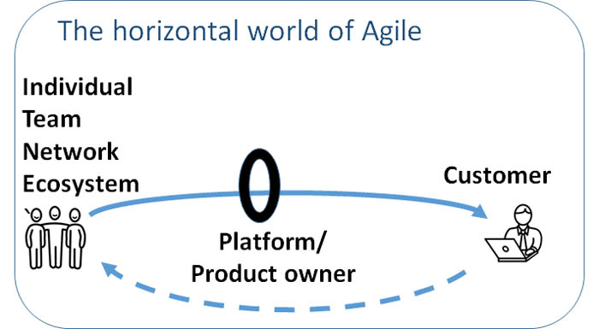
What is the Creative Economy?
A. B. C. D.

Slide 8
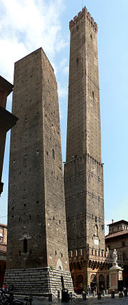
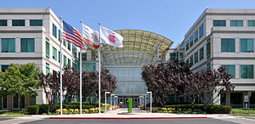
What is the Creative Economy?
A. B. C. D.
Vertical mindset
Horizontal mindset

Slide 9
What is the Creative Economy?
A. B. C. D.
The Copernican Revolution in management
Customer
Firm
The firm
Customer
It is leading to vast economic, social and political change

Slide 10
The transition to the Creative Economy is more difficult than it looks
A. B. C. D.
Traditional Management
The Creative Economy
Goal
Goal
Make money for shareholders
Delighting customers
Communications
Role
Role
From command to conversations
From controller to enabler
Top down commands
Managers are controllers of individuals
Communications
Coordination
Transparency Improvement Sustainability
From value to values
From bureaucracy to Agile, Scrum, Lean
Efficiency, cost cutting
Bureaucracy: rules, plans, reports
Values
Coordination
Values
The elements are interlocking

Slide 11
What is the Creative Economy?
A. B. C. D.
The transition is under way at the team level
Bureaucracy
Agile/Scrum
Boss
Team`
Customer
Product owner
Individuals

Slide 12
What is the Creative Economy?
A. B. C. D.
The transition is also under way at the level of the firm
Traditional economy
Creative economy
Cloud
Teams Networks
Ecosystems
Platform
Customer

Slide 13
What is the Creative Economy?
A. B. C. D.
There are many partial transitions
Plugging Scrum teams into a bureaucracy creates friction
Boss
Boss
Boss
Scrum
Team
Product owner
Boss
Boss
Boss
Customer

Slide 14
What is the Creative Economy?
A. B. C. D.
Poll result from January 21
Where I work, there is tension between way Scrum teams are run and the way the rest of the organization is managed.
Yes | 40%
No | 7%
In part | 36%
Not sure | 3%
Not relevant | 13%

Slide 15
What is the Creative Economy?
A. B. C. D.
Poll:
Where I work, there is tension between way Scrum teams are run and the way the rest of the organization is managed.
Yes
No
To some extent
Not sure
Not relevant to my firm

Slide 16
What is the Creative Economy?
A. B. C. D.
There are many partial transitions
Plugging Scrum teams into a bureaucracy creates friction
Boss
Boss
Boss
Scrum
Team
Product owner
Boss
Boss
Boss
Customer

Slide 17
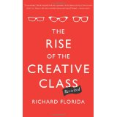
Questions on the Creative Economy
A. B. C. D.
Where did the term, "Creative Economy" come from? Is there a better term? - Sue

Slide 18
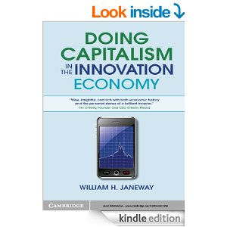
Questions on the Creative Economy
A. B. C. D.
Q. Is there a better term?
Possibilities include:
- Agile?
- the Innovation Economy?
- Innovation Management?
- the Creative Economy?

Slide 19
Questions on the Creative Economy
A. B. C. D.
Q. So what needs to change at the "C" level of a public company to align the paradigm shift now under way at the Scrum team level? – Kurt

Slide 20
The transition to the Creative Economy is more difficult than it looks
A. B. C. D.
Traditional Management
The Creative Economy
Goal
Goal
Make money for shareholders
Delighting customers
Communications
Role
Role
From command to conversations
From controller to enabler
Top down commands
Managers are controllers of individuals
Communications
Coordination
Transparency Improvement Sustainability
From value to values
From bureaucracy to Agile, Scrum, Lean
Efficiency, cost cutting
Bureaucracy: rules, plans, reports
Values
Coordination
Values
The elements are interlocking

Slide 21
What is the Creative Economy?
A. B. C. D.
“Maximizing shareholder value”
Jack Welch former CEO of GE has called it “the dumbest idea in the world.”
Vinci Group Chairman and CEO Xavier Huillard has called it “totally idiotic.”
Alibaba CEO Jack Ma has said that “customers are number one; employees are number two and shareholders are number three.”
Paul Polman, CEO of Unilever [has denounced “the cult of shareholder value.”
John Mackey at Whole Foods has condemned businesses that “view their purpose as profit maximization and treat all participants in the system as means to that end.”
Just two weeks ago, Marc Benioff, CEO of Salesforce declared that this still-pervasive business theory is “wrong.”

Slide 22
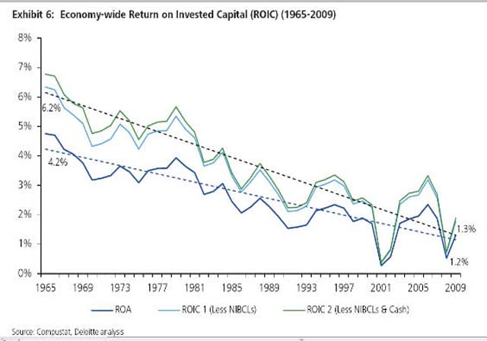
What is the Creative Economy?
A. B. C. D.
Economics is driving change
ROA and ROIC on US firms 1965-2011: Deloitte Center for the Edge
For more and more firms, the question is: change or die

Slide 23
Questions on the Creative Economy
A. B. C. D.
Q. Is traditional leadership is willing to lose power moving to Agile where the power resides in the team? – Fernando, Michael
Bureaucracy
Agile/Scrum
Boss
Team`
Customer
Product owner
Individuals

Slide 24
What is the Creative Economy?
A. B. C. D.
Q. Have the firms you sometimes cite as exemplars like Apple, Amazon, Google or Salesforce really made the transition?
Aren’t they just as bureaucratic as the old dinosaurs?

Slide 25
What is the Creative Economy?
A. B. C. D.
Q. Is W.L. Gore & Associates an example of a firm that has made the journey to the Creative Economy?

Slide 26
What is the Creative Economy? Scaling…
A. B. C. D.
Q. Does this have anything to do about “scaling”?
Teams
Enterprise

Slide 27
What is the Creative Economy? Scaling…
A. B. C. D.
At the TEAM Level
At the ENTERPRISE Level
Scrum
XP
Lean…
Converged Agile Values and Principals
SAFe
LeSS
Unscaling…
?
(Still in Divergent stage)

Slide 28
What is the Creative Economy? Scaling…
A. B. C. D.
Friction in 88% of Cases
Boss
Boss
Boss
Scrum
Team
Product owner
Boss
Boss
Boss
Customer

Slide 29
What is the Creative Economy? Scaling…
A. B. C. D.
Scaling at the level of:
1. multiple teams working on the same product
2. multiple teams working on different products
3. cultural change throughout the organization

Slide 30
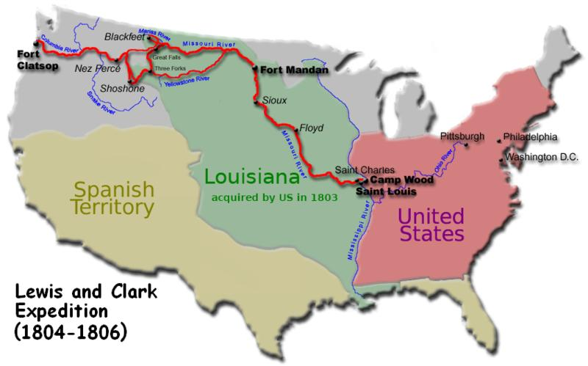
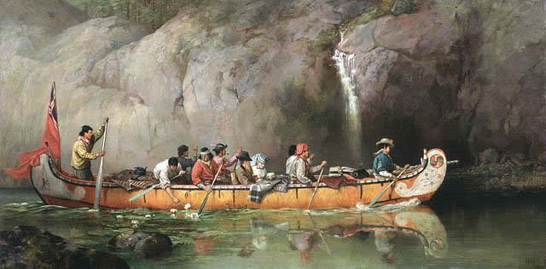
What is the Creative Economy? Scaling…
A. B. C. D.
Benefit for Peer-to-Peer Learning:
A Journey of Discovery
Scaling Territory

Slide 31
What is the Creative Economy?
A. B. C. D.
Poll
I am optimistic that my firm can make the transition to the Creative Economy
Yes
No
Not sure
Not relevant

Slide 32
What is the Learning Consortium?
A. B. C. D.
C. How can firms learn how to make this difficult transition?
One suggestion:
A Learning Consortium

Slide 33
What is the Learning Consortium?
A. B. C. D.
What is the Learning Consortium?
The Learning Consortium enables firms that are on a journey towards the Creative Economy with more Agile modes of operating and continuous customer-focused innovation to work together to enable each member to optimize their competitiveness in a win-win environment using shared resources, experience and trust..

Slide 34
What is the Learning Consortium?
A. B. C. D.
How the Learning Consortium will work
We are inviting a group of firms to join the Consortium by end-February 2015.
Members will share their progress on the shift to the Creative Economy
Members will select the five most interesting firms for site visits.
Site visits will take place from April through September 2015.
An on-line conversation space for members will be established.
An informal advisory panel will be available for consultation by members.
A conference will be organized later in 2015.
A report on findings of the consortium will be prepared in consultation with members

Slide 35
What is the Learning Consortium?
A. B. C. D.
What are the benefits of joining the Consortium ?
Member Direct benefits
Peer-to-peer learning on site visits
A forum for trusted conversations in a safe space
Informal learning from other participants
On-line learning in real-time
The Learning Consortium conference and report
Indirect benefits
Member-determined agenda
Access to core-team and the informal advisory panel
Assurance of state-of-the-art expertise
Brand recognition as an innovative company
Enhanced personal networks in management innovation

Slide 36
How can you help?
A. B. C. D.
Who are the likely members of the Learning Consortium?

Slide 37
What is the Learning Consortium?
A. B. C. D.
Who can join the Learning Consortium?
Any organization can join that is:
Wanting to accelerate its journey towards the Creative Economy
Keen to learn from other practitioners on the same journey
Willing to share its experience with other practitioners
Able to pay an administrative fee (now fixed at US $ 7,500)
Willing to accept the Code of Ethics, which includes:
No selling of services in the course of the Consortium
No solicitation of staff by means of the Consortium

Slide 38
How can you help?
A. B. C. D.
What about including other methodologies like Kanban? – Linda, Ricardo
Q. What are the future plans to expand to other places like Africa or Latin America? - Tony
What about small firms? - Alex
Q. Can an association join? – Alexander
Q. Is the fee reasonable? - Christina

Slide 39
How can you help?
A. B. C. D.
Q. Are you looking for C-suite participants in the Learning Consortium? People lower down may not have needed influence. – Jeff Q. Would participating in the Learning Consortium make sense for consulting organizations? – Amy Q. Could Registered Educational Providers (REPs) join? – Donna Q. If my organization decides not to join, can I join as an individual? – Iwona

Slide 40
What is the Learning Consortium?
A. B. C. D.
How can you help the Learning Consortium?
You could help us identify more member candidates
Is your firm
On a journey towards the Creative Economy?
Interested in learning from other practitioners?
Willing to share its experience?
Let us know. We would love to talk with you.
Contact: learningconsortium@scrumalliance.org

Slide 41
What is the Learning Consortium?
A. B. C. D.
Questions?

Slide 42
How can you help?
A. B. C. D.
Poll
I want to be kept informed about progress of the Learning Consortium
I want to participate in a series of webinars on the Creative Economy
I want to participate in an (asynchronous) online Google group discussion about the Learning Consortium.
I want to participate in a "community of practice" on the Creative Economy.
I am interested in establishing and leading such a community of practice.

Slide 43
Thank you for attending
The Learning Consortium for the Creative Economy
February 19, 2015

